Slide 2
DevOps and Tooling for the Hybrid Cloud
BRK3288
Shriram Natarajan
Siddique Juman
Program Managers, Microsoft Azure Stack

Slide 3
Session learning objectives
At the end of this session, you should be better able to:
Onboard to Microsoft DevOps Pipeline quickly
Understand Hybrid DevOps with Azure & Azure Stack

Slide 4
Assumptions
You’re familiar with DevOps in general
You’re familiar with Azure and Azure Stack value propositions
You’re somewhat familiar with the services in Azure Stack

Slide 5
Agenda
DevOps on Azure and Azure Stack
What you can do today
Considerations / Gaps
How we’re addressing them

Slide 6

What is DevOps?
“Development and Operations collaboration”
“Automation”
“Faster and smaller releases”
“A job title”

Slide 7

What is DevOps?
People. Process. Technology.
DevOps is the union of people, process, and technology to enable continuous delivery of value to your end users.
“
Plan & Track
Agile Planning
Dashboards
Kanban Boards
Task boards
Build & Test
Git Source Control
Modern Code Workflow
Continuous Integration
Continuous Testing
Package Management
Open Source Compliance
Develop + Test
Plan + Track
Continuous
Delivery
Monitoring & Operations
Telemetry
Diagnostics
Analysis
Compliance
Release
Deployment
Deployment of app and infrastructure
PaaS, IaaS and Containers
Monitor + Operate

Slide 8











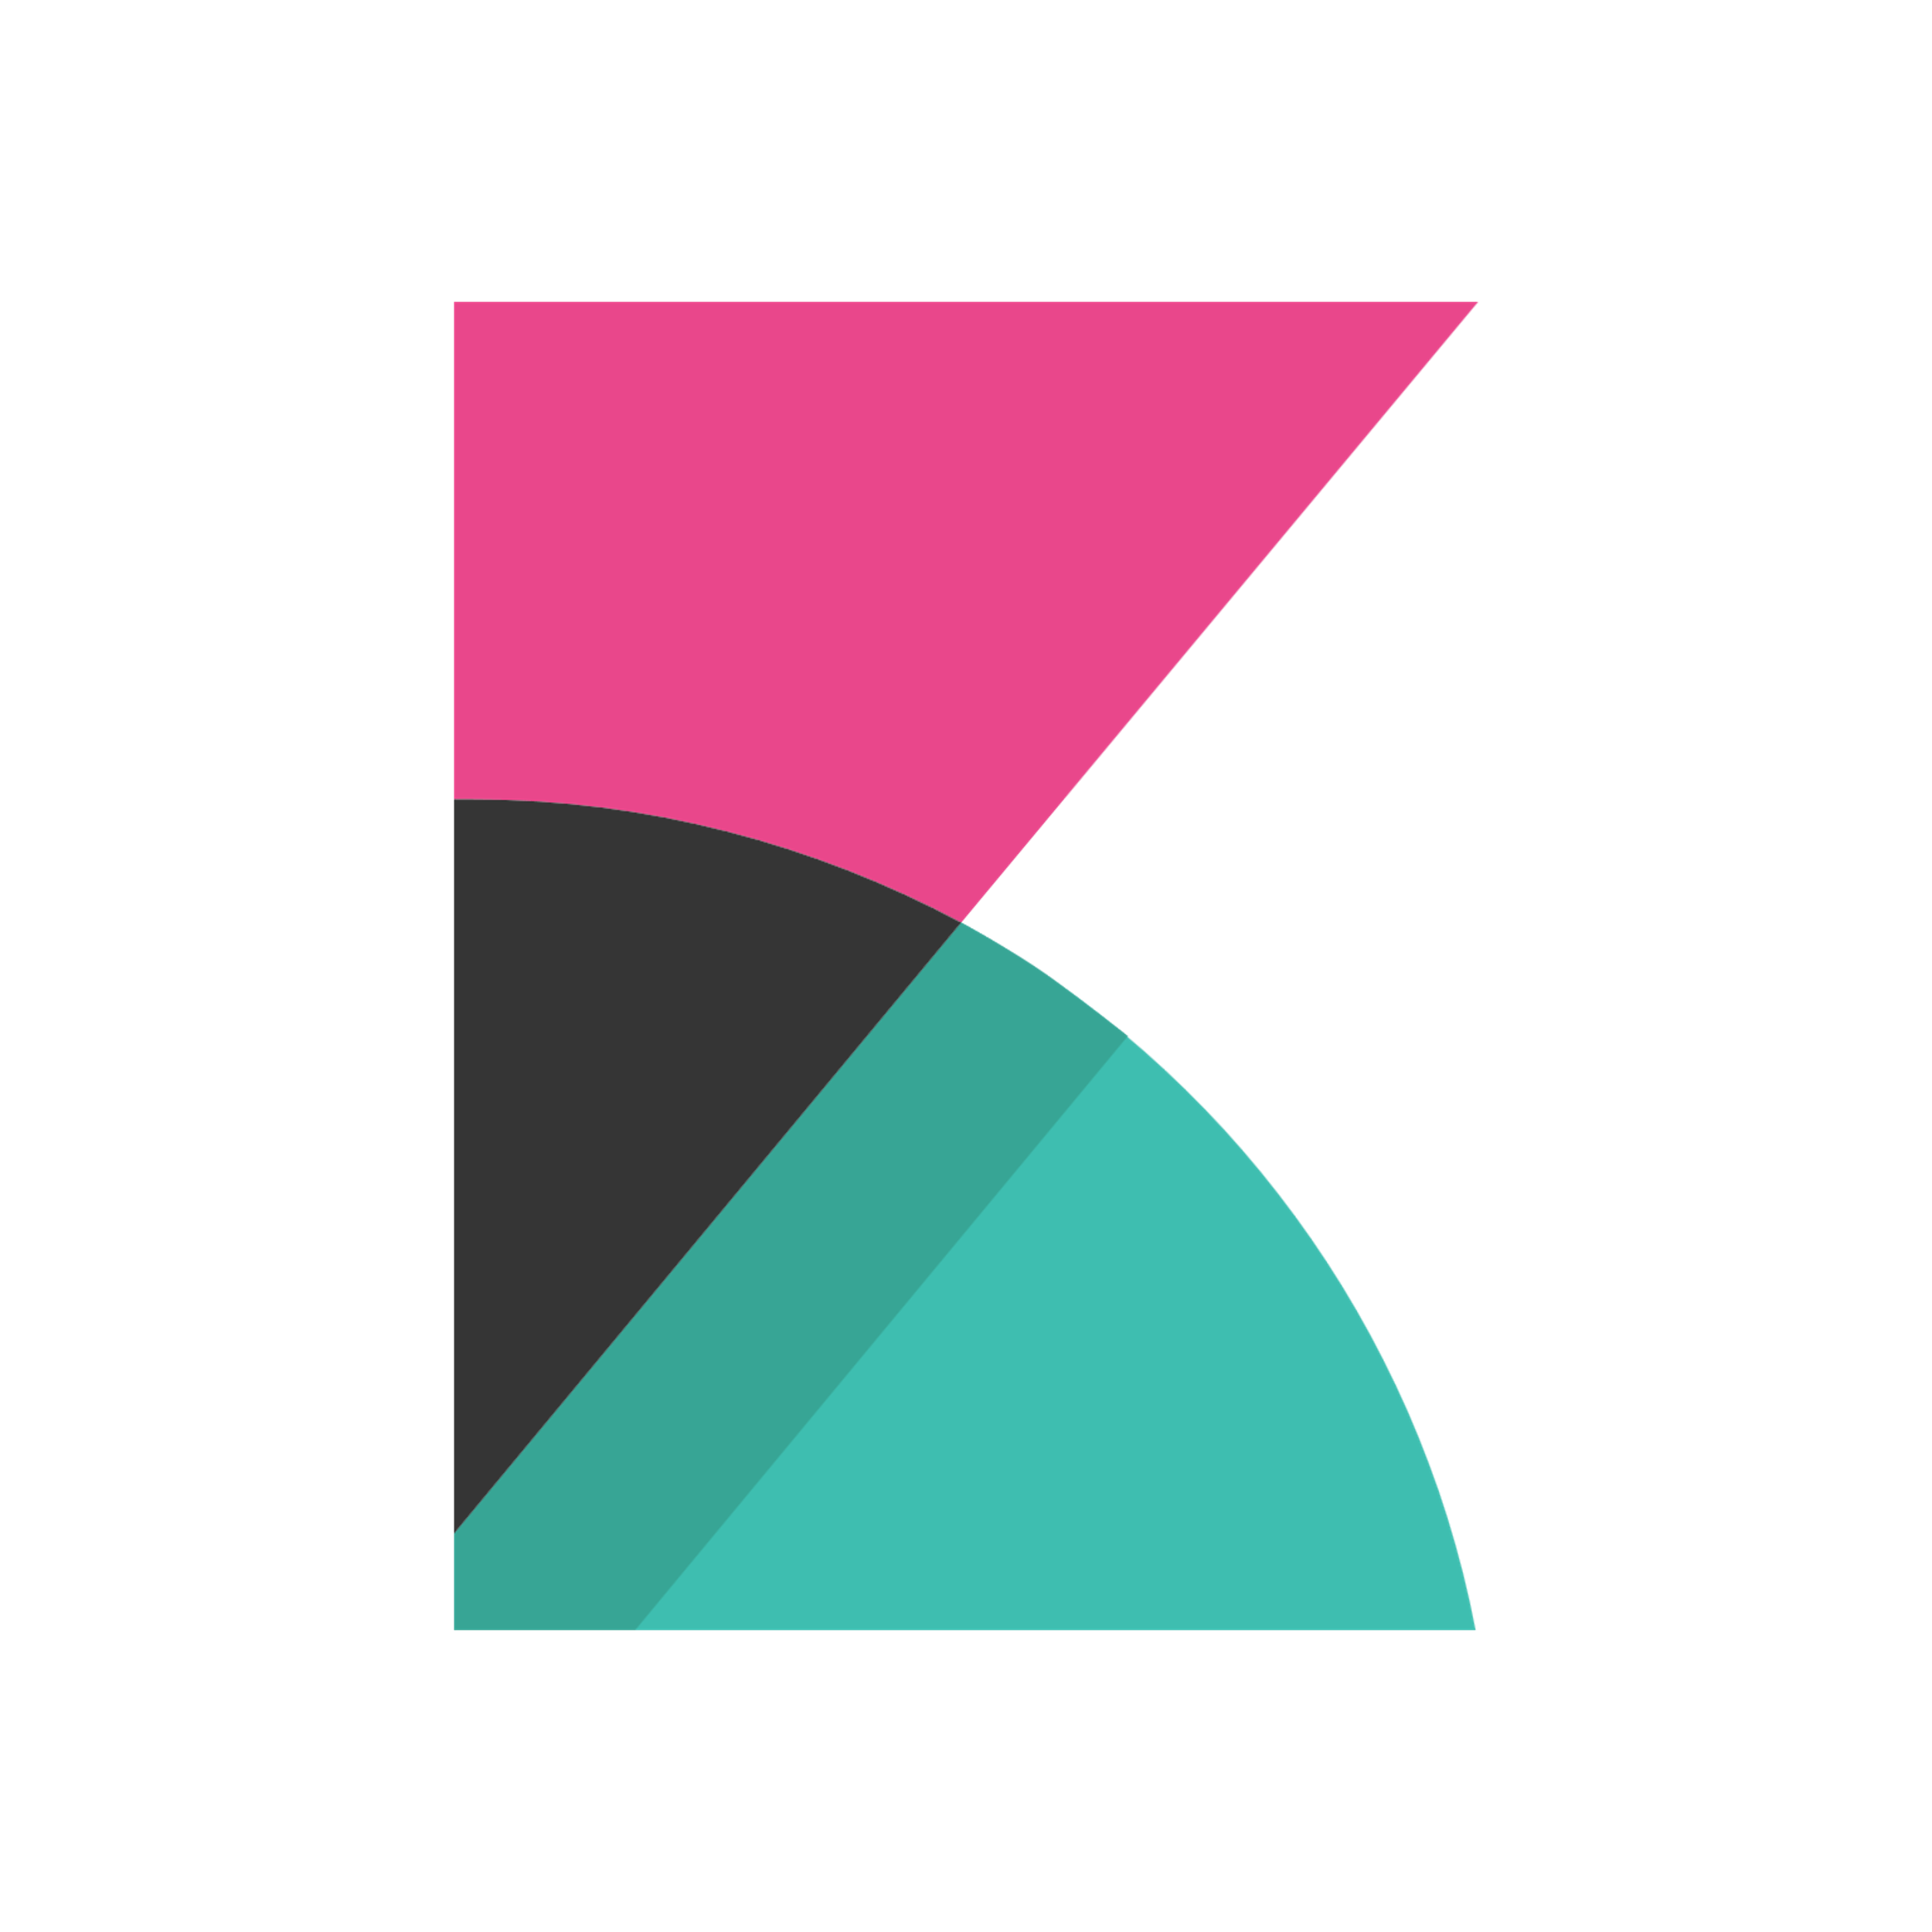
Azure DevOps framework
Plan and track
Code
Build and test
Deploy
Operate
Monitor
Azure Boards
Azure Repos
Azure Pipelines
Azure Pipelines
Key Vault
Application
Insights
Trello
GitHub
Jenkins
Terraform
Ansible
ELK Stack

Slide 9

Hybrid Pipeline with Azure and Azure Stack
Azure Public Clouds
Azure Stack Clouds

Slide 10
Consistent Application Development

Slide 11
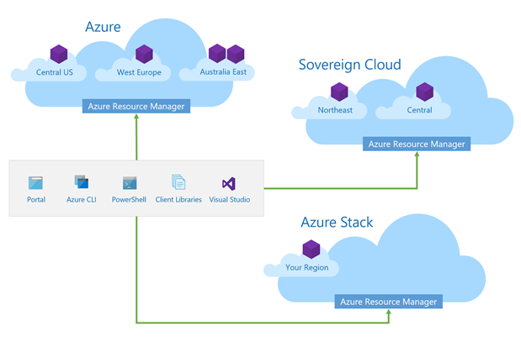
Consistent Application Development
Build and deploy apps the same way, for any Azure Cloud
Implement Common DevOps Practices
Use the same tools across Azure Clouds

Slide 12
Consistent App Development with Visual Studio
Siddique Juman

Slide 13
Consistent
Application Development
Service
Consistency
Tooling
Consistency

Slide 14
Service Consistency across all Azure Clouds

Slide 15

Deploy repeatedly & reliably using ARM
Describe
Deploy
Control
Azure Resource Manager & DevOps Tool Integrations
Infrastructure as Code (IaaC), built-in with Azure Resource Manager
Consistent between Azure and Azure Stack
Support for DevOps tools integrations and OSS tooling
Azure Resource Manager
Azure Resource Manager
Azure Stack
Azure

Slide 16

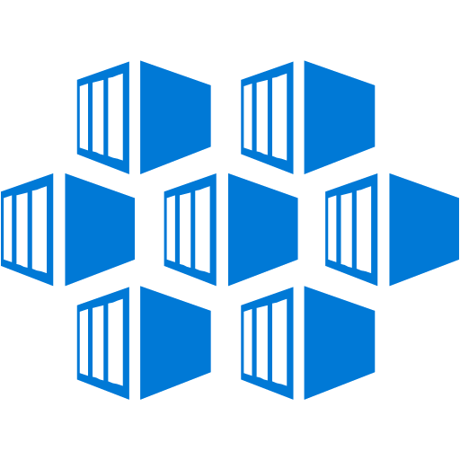


Consistent Cloud Platform
Tools
Experiences
Deployments
App development and operations
Application Patterns
Automations
Operations
Serverless
App Service
Containers
Marketplace
Azure services
Virtual machines
Networking
Storage
Key Vault
Azure
Consistency
Azure
Stack

Slide 17
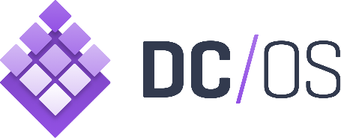















One Azure ecosystem
Work with the tools and technologies you want across Azure and Azure Stack
Goal: Applications and services that are certified for Azure work on Azure Stack

Slide 18
Tooling Consistency across all Azure Clouds

Slide 19







Develop
Visual Studio Tools
Visual Studio Cloud Explorer
Azure Tools
Deploy and Manage
Trusted
Consistent Tooling across clouds
Productive
Intelligent
Hybrid
Azure CLI
Azure SDKs (.Net, Java etc…)
Azure PowerShell
Azure Storage Explorer
Monitor
Log Analytics
Application Insights

Slide 20
Azure Storage Explorer
Siddique Juman

Slide 21
Putting it all together Integrating into a Hybrid DevOps pipeline

Slide 22
Hybrid DevOps Pipeline - Architecture

Slide 23
Hybrid DevOps Pipeline - Architecture
Code
Use Visual Studio or Visual Studio Code
Synchronize Repositories to Dev env
Define Infra for app using ARM templates
Maintain code for Application separately

Slide 24
Hybrid DevOps Pipeline - Architecture
Build
Build Agent hosted in Azure
Set up for Continuous Integration

Slide 25
Hybrid DevOps Pipeline - Architecture
Release to Azure
Create/Update Web App Infra on App Svcs through ARM template on Azure
Publish code to Web App

Slide 26
Hybrid DevOps Pipeline - Architecture
Release to Azure Stack
Release Agent hosted on-prem
Release Agent has access to Azure Stack
Create/Update Web App Infra on App Svcs through ARM template on Azure Stack
Publish code to Web App

Slide 27
Hybrid DevOps Pipeline - Architecture
Monitor Applications
Use Application Insights in Azure to monitor resources in Azure and Azure Stack

Slide 28
Hybrid Pipeline Azure DevOps + Azure + Azure Stack
Siddique Juman

Slide 29
Considerations Things to keep in mind while implementing hybrid DevOps

Slide 30
“
“
The journey of a thousand miles begins with one step.
-Lao Tzu

Slide 31
Considerations
Service
Considerations
Tooling
Considerations

Slide 32
Service Considerations between Azure Clouds

Slide 33
Service Considerations between Azure Clouds
Azure Stack services will lag their Azure counterparts
API versions are different across different Azure clouds
Our Goals:
Closing Service versions
Unified Programming models accounting for different versions

Slide 34
Solution: API Profiles

Slide 35
API Profiles
Sets of namespaces and API versions
Ensures template and tooling compatibility across Azure Clouds
Couple code to Profiles
Four profiles per year

Slide 36


Profile Types
latest
Most recent API versions released in Azure
yyyy-mm-dd-profile
Sits between optimal stability and cutting edge of “latest”
yyyy-mm-dd-hybrid
Released two times per year for hybrid development

Slide 37
Current Profiles
latest
2017-03-09-profile
2018-03-01-hybrid

Slide 38
Using API Profiles to target different services
Siddique Juman

Slide 39
Tooling Considerations between Azure Clouds

Slide 40
Considerations for Tools to enable hybrid applications
No Hardcoded Endpoints
AAD vs AD FS support
No Strict coupling to Azure API versions
https://aka.ms/consistency

Slide 41
Solution: Hybrid App patterns, 1:1 engagements

Slide 42



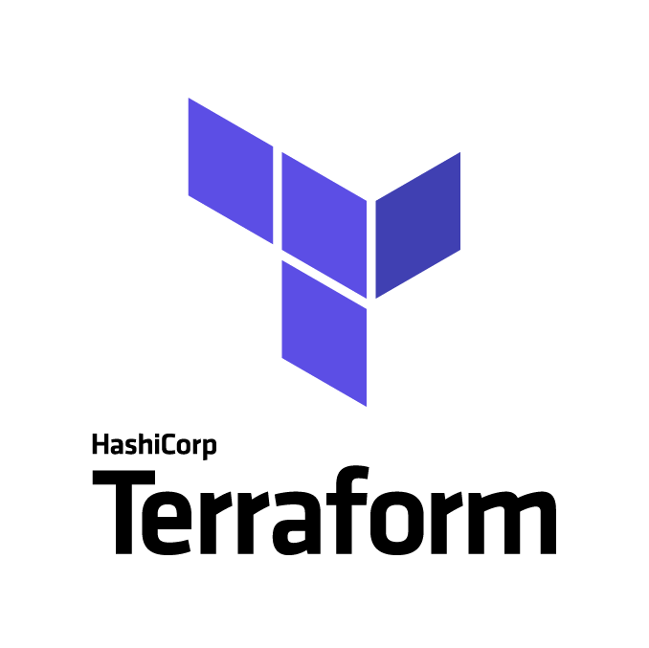
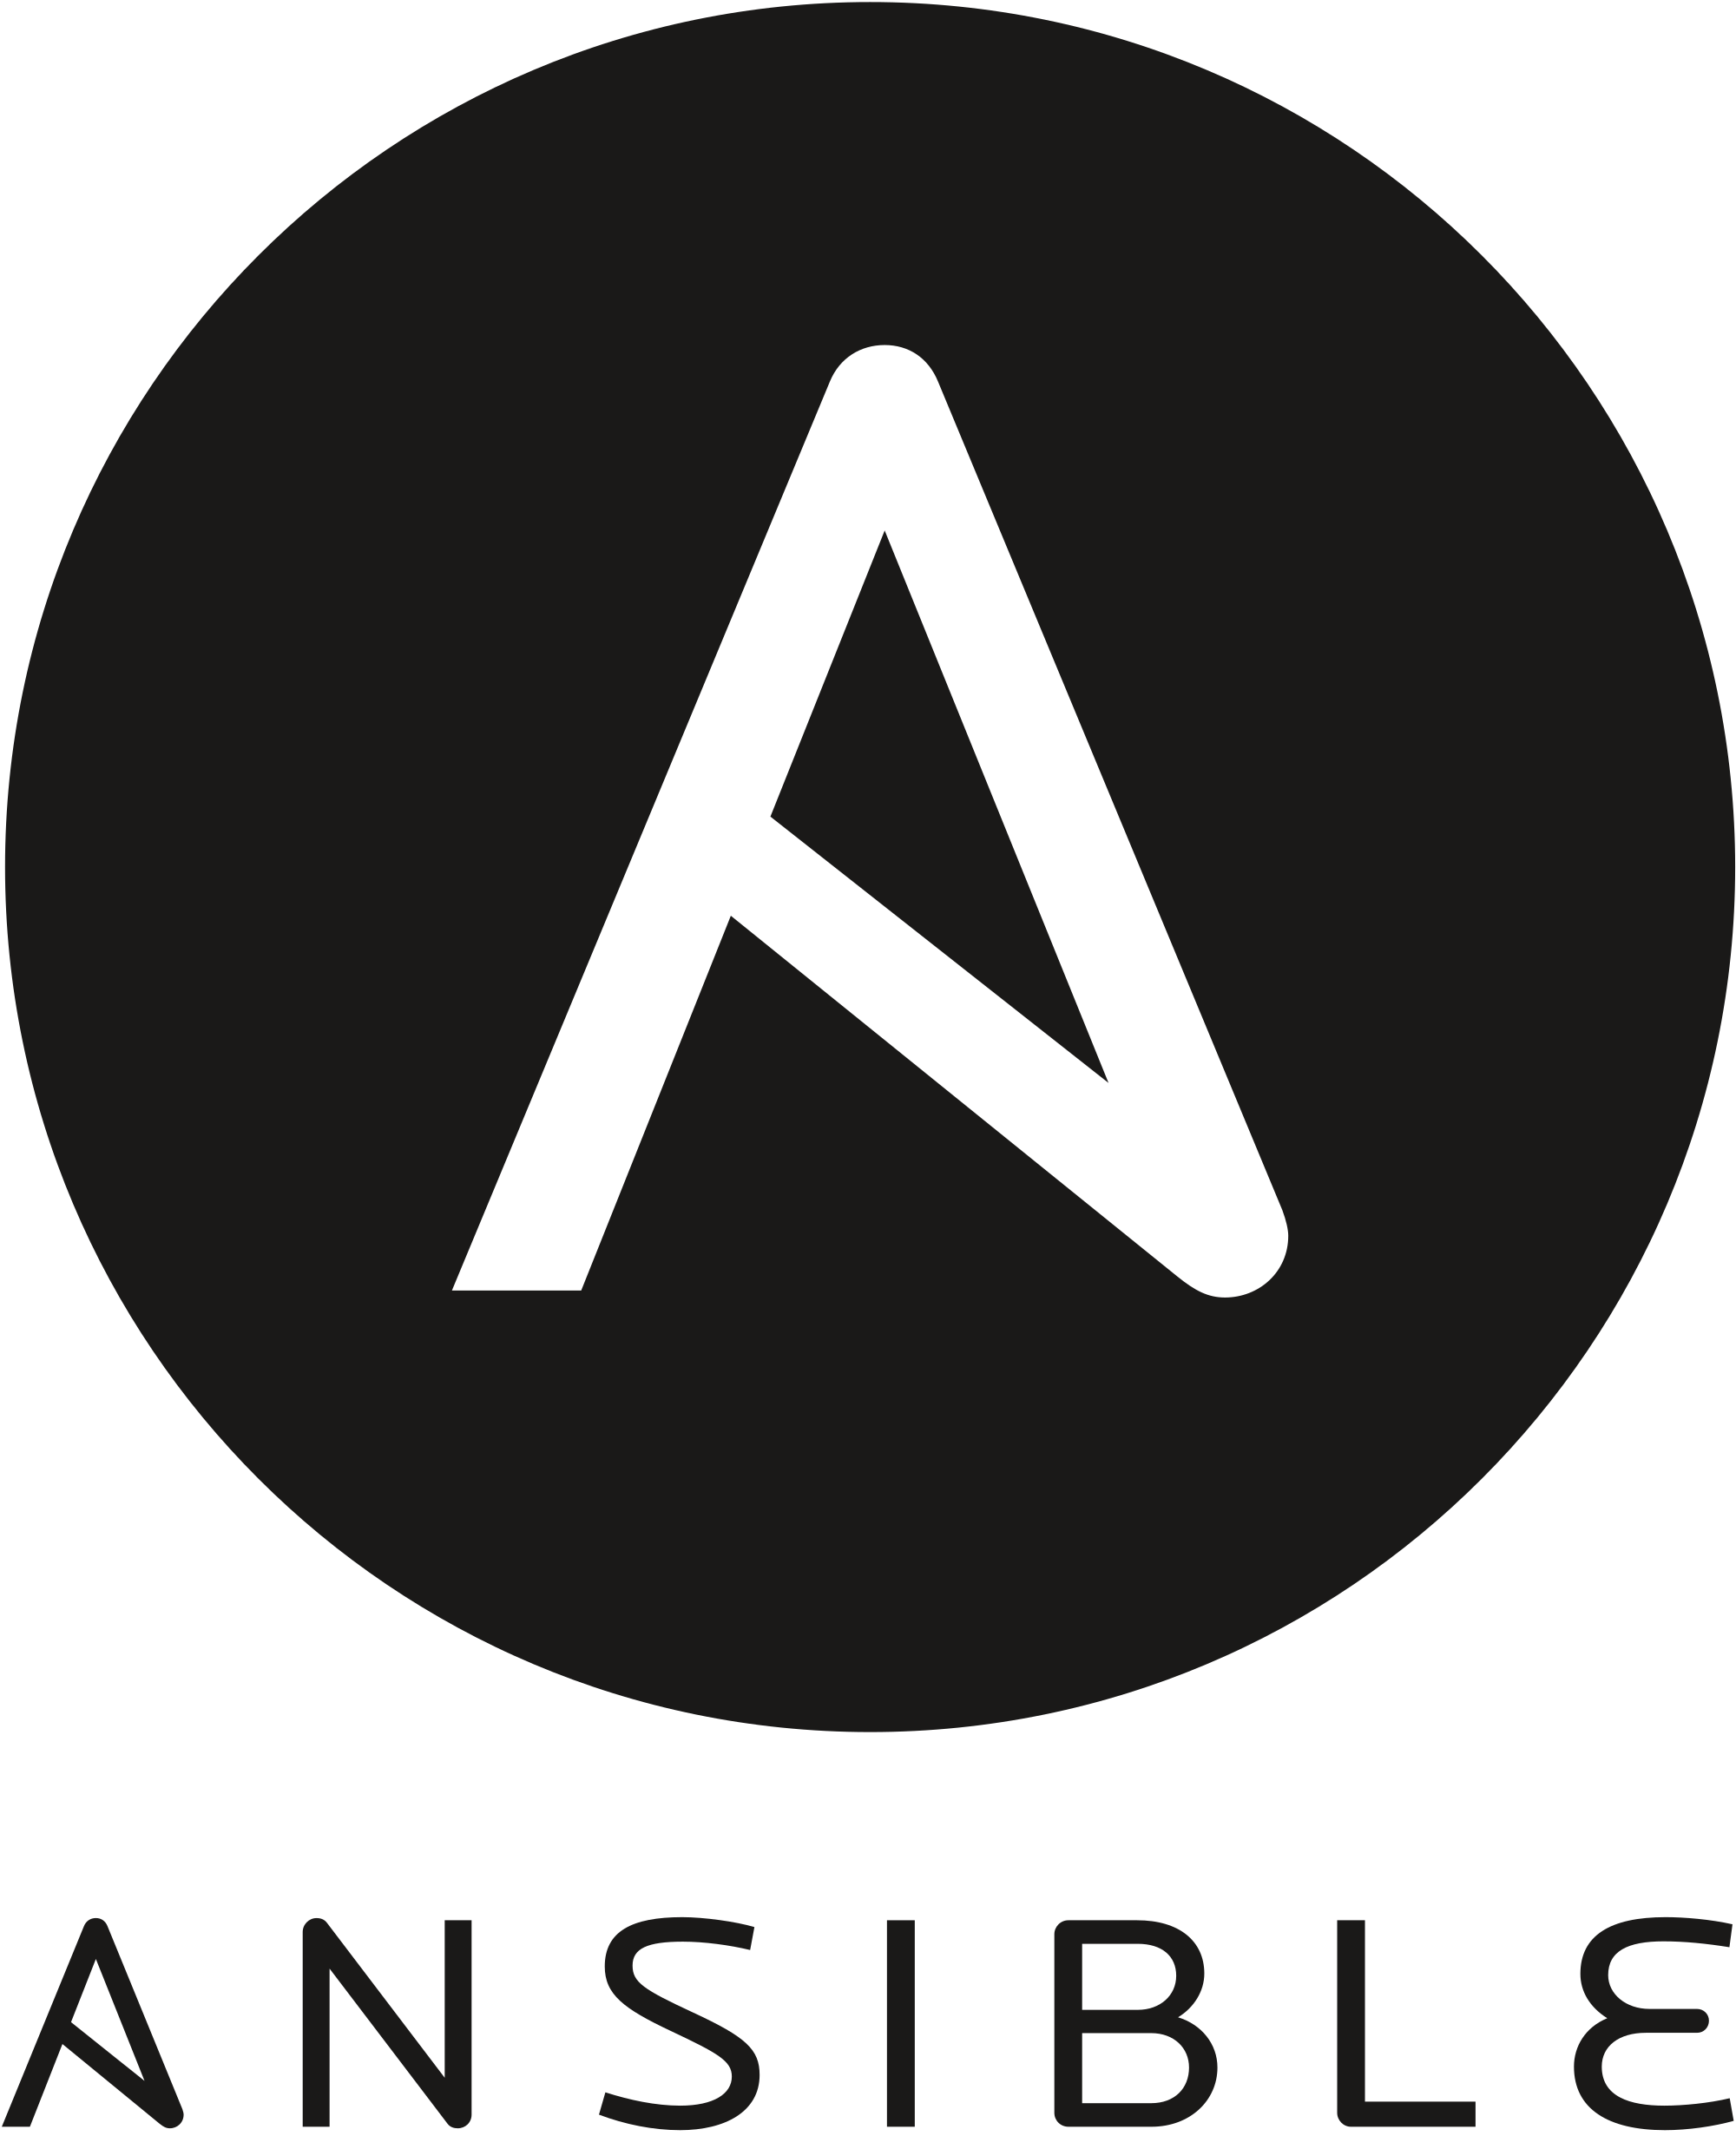
Support from more tools coming soon…
Tools Available Today
Azure Service Fabric

Slide 43
Please evaluate this session Your feedback is important to us!
Please evaluate this session through MyEvaluations on the mobile app or website.
Download the app: https://aka.ms/ignite.mobileApp
Go to the website: https://myignite.techcommunity.microsoft.com/evaluations

